Slide 1
MINI PROJECT NFT Based Crypto Analysis
UNDER THE GUIDANCE OF : DONE BY:
PROF.C.DEEPA [MSC,MPHIL,MA(YOGA),PHD] SANJAY.K
DEPARTMENT OF SOFTWARE 3RD YEAR SOFTWARE SYSTEMS SYSTEMS
PSG COLLEGE OF ARTS & PSG COLLEGE OF ARTS &
SCIENCE SCIENCE
COIMBATORE - 641014 COIMBATORE - 641014

Slide 2
AGENDA
ABSTRACT
EXISTING AND PROPOSED SYSTEM
MODULE
HARDWARE AND SOFTWARE SPECIFICATIONS
FLOWCHART
SAMPLE IMAGES

Slide 3
ABSTRACT
In this project we attempt to implement ml approach to predict NFT based crypto( Dogecoin ).
The objective is to predict the Dogecoin price in order to make more informed and accurate investment decision.
autoTS is a very powerful automated machine learning algorithm which is used to predict values with higher accuracy from time to time.
The previous prices of Dogecoin is important because it is crucial to predict the future price of Dogecoin

Slide 4
EXISTING SYSTEM
The existing system uses machine learning models such as Randomforestregressor, fbprophet, LSTM etc..which produces less accuracy
The existing system cannot deal with NaN values or it should be cleared manually.
It takes more time to process the output

Slide 5
PROPOSED SYSTEM
The working of the model is done by autoTS which deals with the NaN values automatically
It produces an accuracy around 80% to 85% while using medium dataset and 94.5% while using large dataset
The autoTS machine learning algorithm takes less time to process the output.
It supports multivariate outputs

Slide 6
MODULES
Collection of Dataset
Checking the Dataset for empty values and Noisy or unwanted data
Splitting the data into Training data and Test data
Training the model using autoTS python library
Printing the predicted values with accuracy ratio

Slide 7
HARDWARE SPECIFICATIONS
Processor : Intel core i3 or above and AMD Ryzen 3 or above
Hard disk : 100 GB
Ram : 4 GB
Keyboard : 104 Standard keys
Mouse : Optimal Mouse

Slide 8
SOFTWARE SPECIFICATIONS
Supported Environment : Windows 7 or above, Linux OS, Mac OS
Third party tools : Anaconda Navigator, VS code
Coding Language : Python

Slide 9
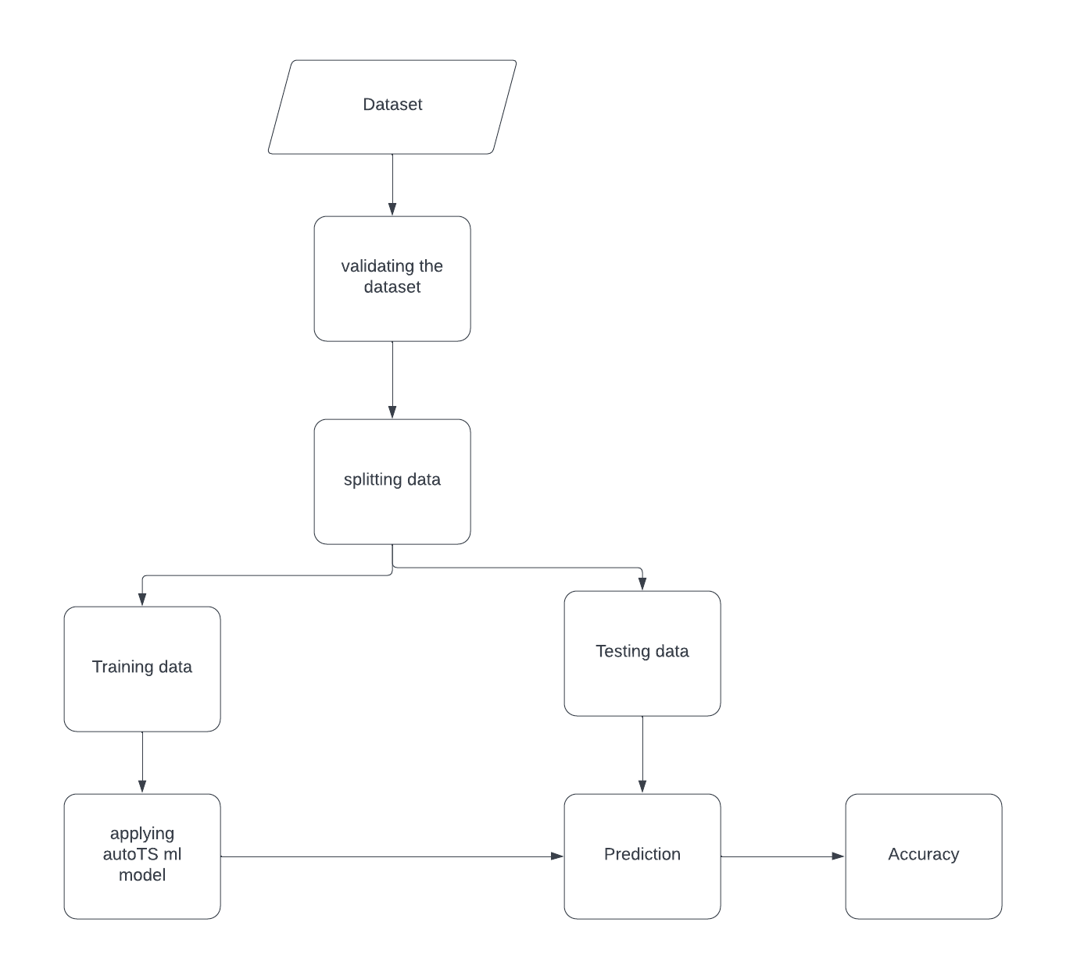
FLOWCHART

Slide 10
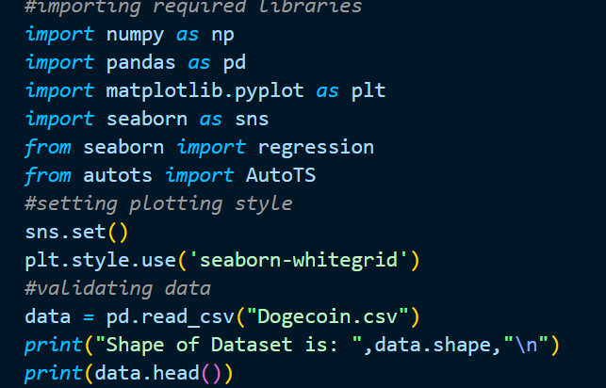
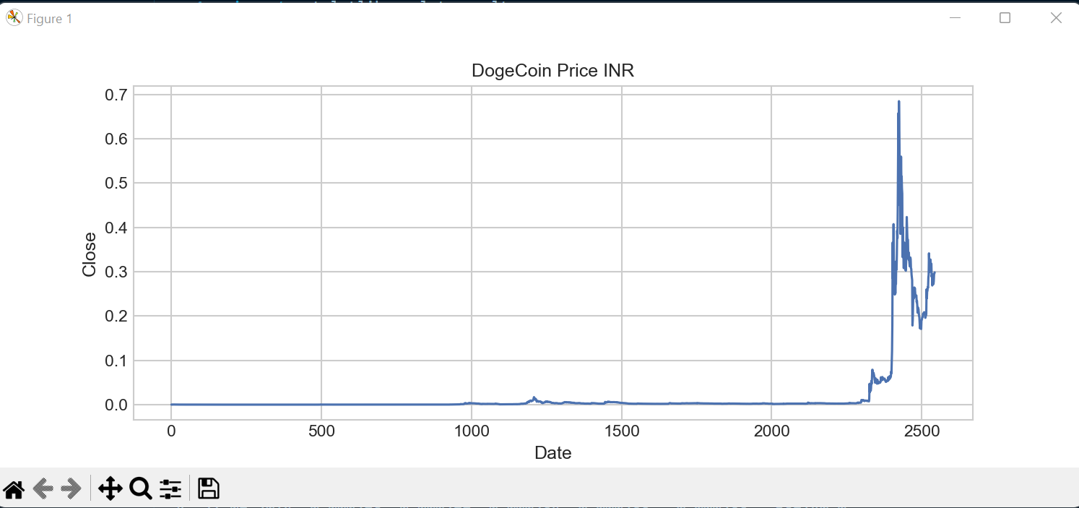
SAMPLE IMAGES

Slide 11
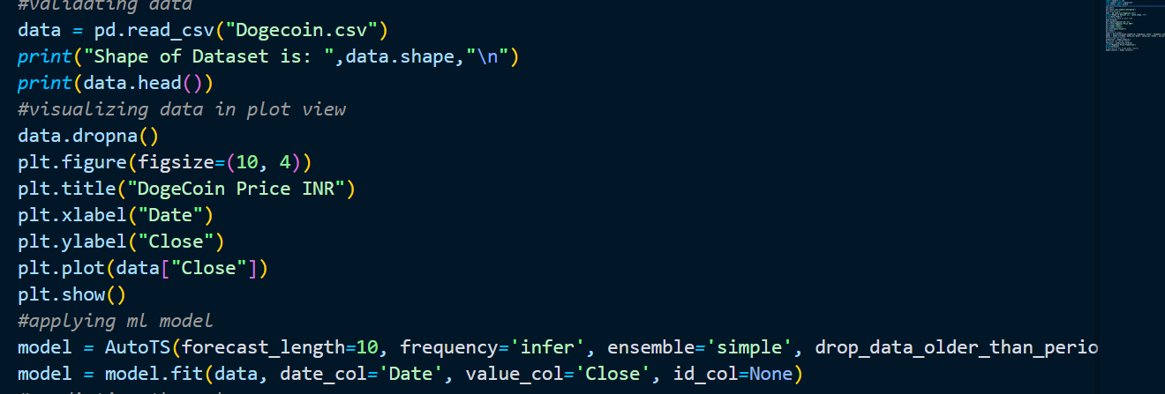

Slide 12
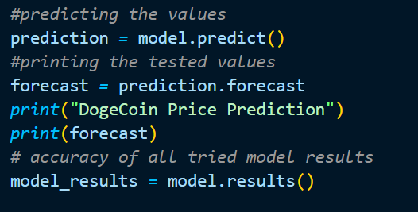
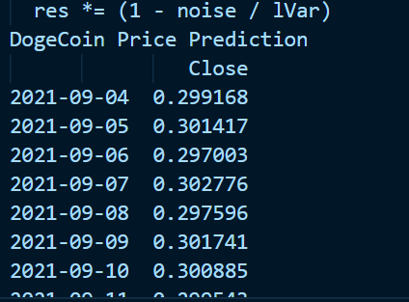

Slide 13
THANK YOU

